Slide 1
Chapter 5 Data Analysis

Slide 2
Chapter 5 Outline
Data tools
Big data overview
Machine Learning algorithm

Slide 3
Chapter 5 Outline
Data tools

Slide 4
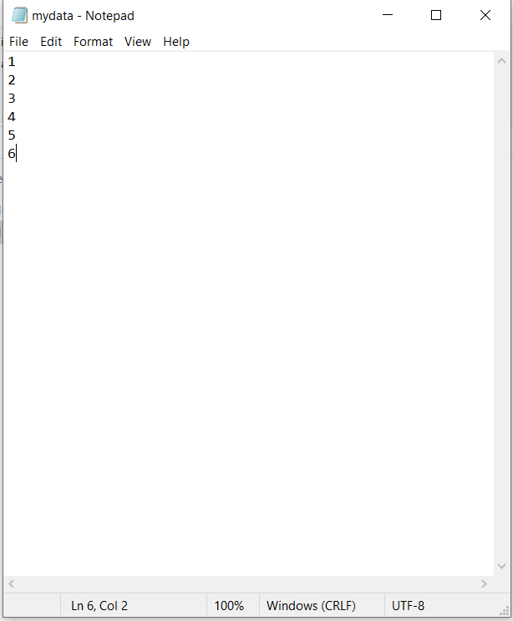
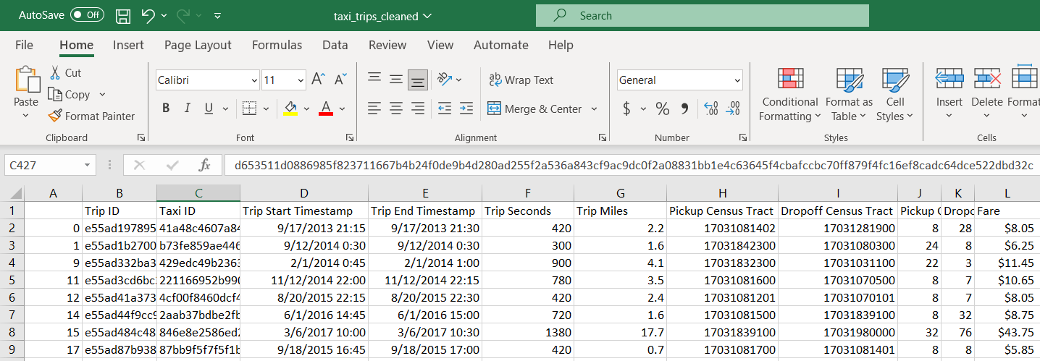
Storing data sets
.txt
.csv
Spreadsheets
Database

Slide 5
Computing basic statistics
Total number of data entries
Max & Min
Average, Median, STD, Sum
Summarizing by groups

Slide 6
Data Analysis Case Study – Uber Air Taxi
Introduction
Background: In 2016, Uber published a whitepaper describing the possibilities of on-demand air travel in cities. Our goal is to analyze the feasibility of such an operation by simulating air taxi trips in Chicago.
Dataset: See CSV file

Slide 7
Uber Air Taxi – Compute Basic Statistics
See jupyter notebook

Slide 8
Finding patterns in data sets
Trend
Making predictions
Linear Regression
Correlations

Slide 9
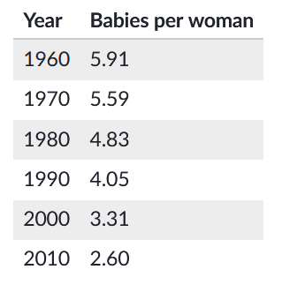
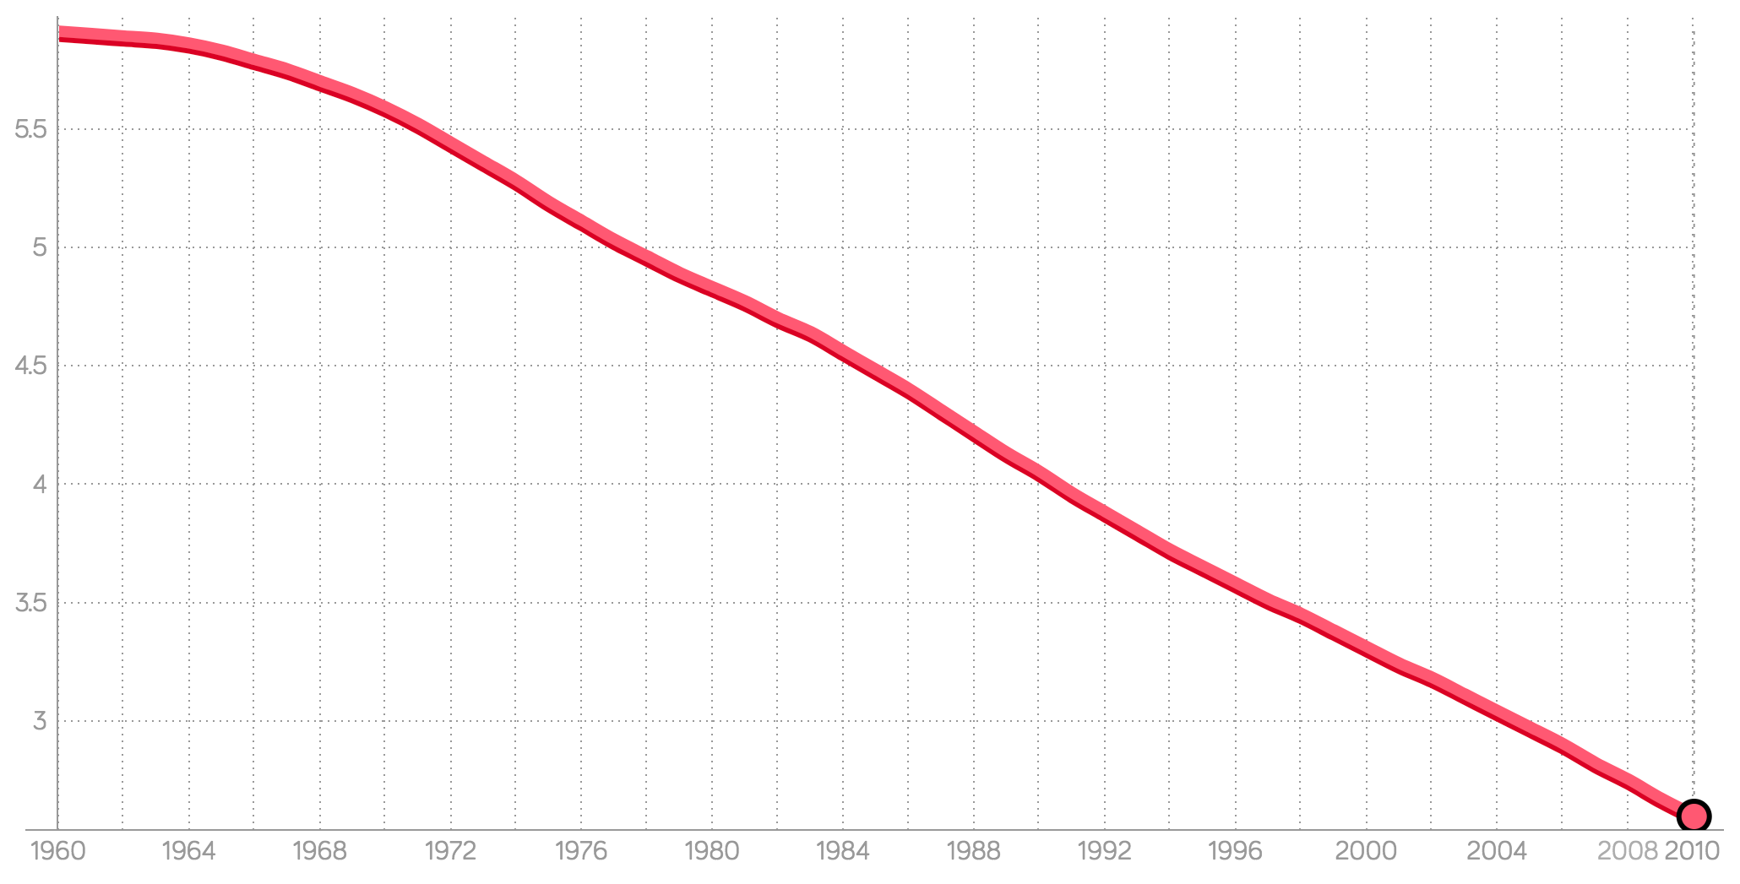
Spotting Trend

Slide 10
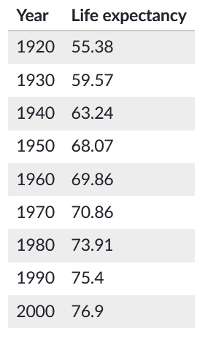
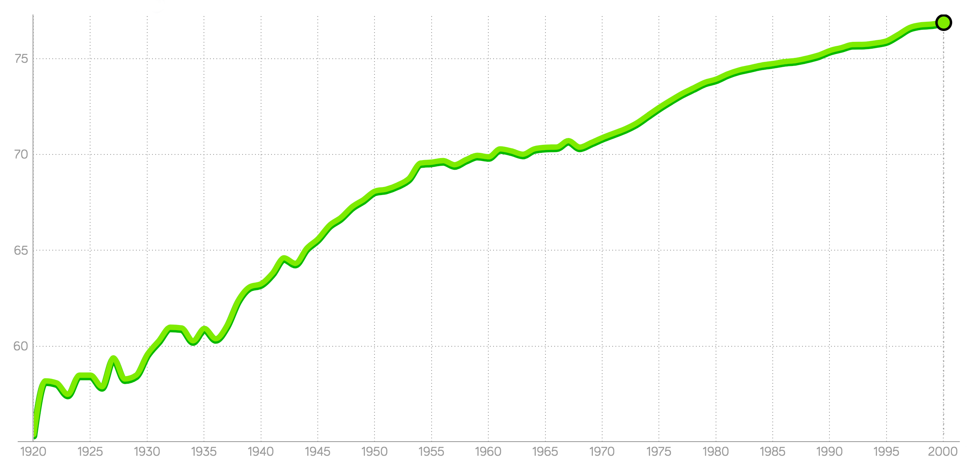

Slide 11
Making predictions – Linear Regression

Slide 12
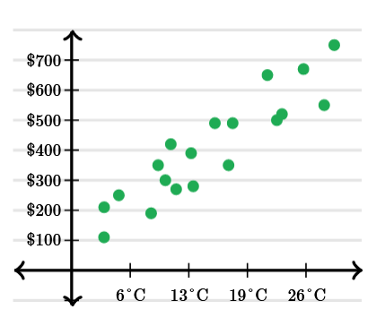
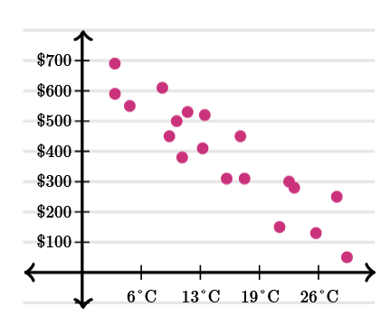
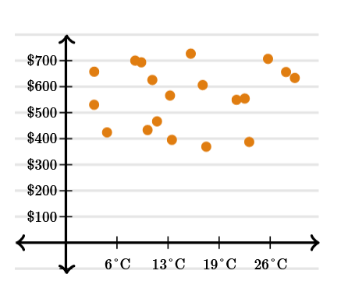
Find Correlations
Temperature v.s. Ice Cream sales
Temperature v.s. Soup sales
Temperature v.s. Salt sales

Slide 13
Chapter 5 Outline
Data tools
Big Data

Slide 14
Big Data
Big data refers to extremely large and diverse collections of data that continues to grow exponentially over time. These datasets are so huge and complex in volume, velocity, and variety, that traditional data management systems cannot store, process, and analyze them (Google Cloud)

Slide 15
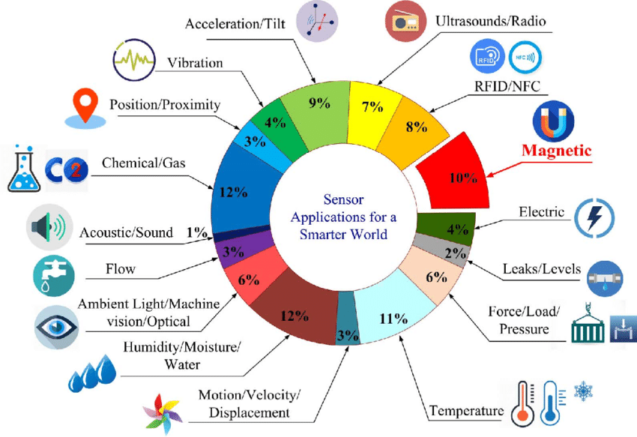
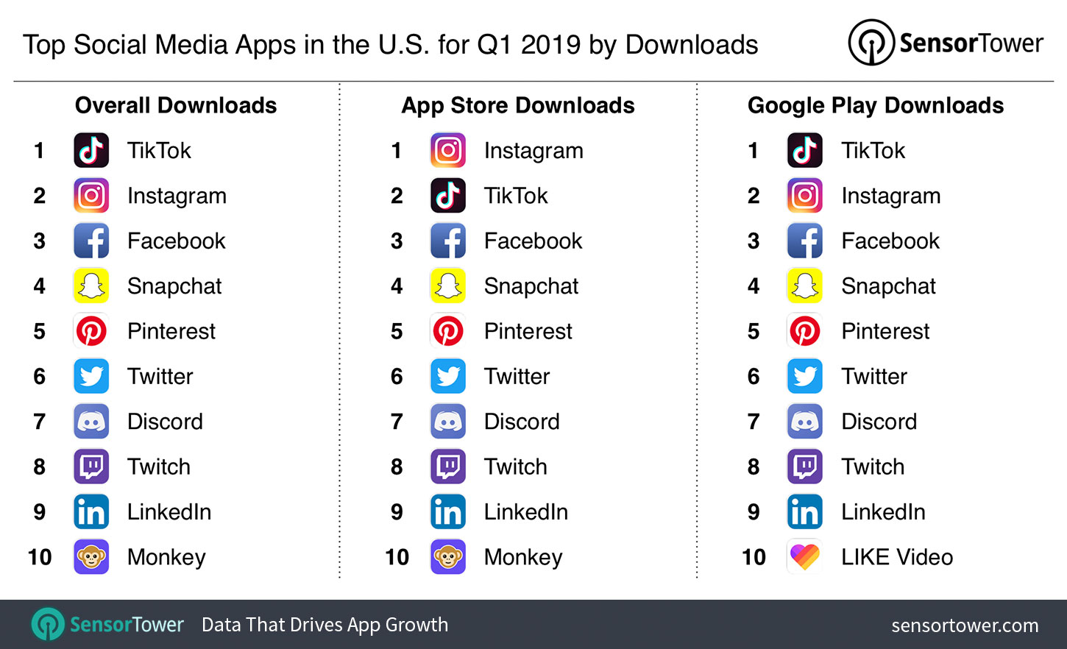
The sources of big data
Sensor data from IoT devices
15.14 billion IoT devices (ComTIA)
Now imagine each of those 145,743 sensors generating 100 bytes of data every minute resulting in a data volume of nearly 21GB per day (sqlStream)
Social Media data
As of 2023, the average number of videos uploaded to TikTok each day is estimated to be around 10 million.
Healthcare
Today, more than 40 million MRI scans are carried out every year in the U.S. (UC Berkeley Research)
A single MRI scan results in 20,000 images. (Khan Academy)
…

Slide 16
The challenges with big data
Storing
Processing

Slide 17

Big data storage
Data centers

Slide 18
Big data processing
Let's imagine that engineers at Twitter want to determine how many tweets contain a particular hashtag (e.g. "#ClimateCrisis")
The code to determine whether a single tweet contains the hashtag requires only a tenth of a millisecond, or 0.0001 seconds
The code to analyze 500 million tweets (the amount posted each day) would require this much time:
0.0001 * 500,000,000 = 50,000 seconds = 13.4 hours

Slide 19
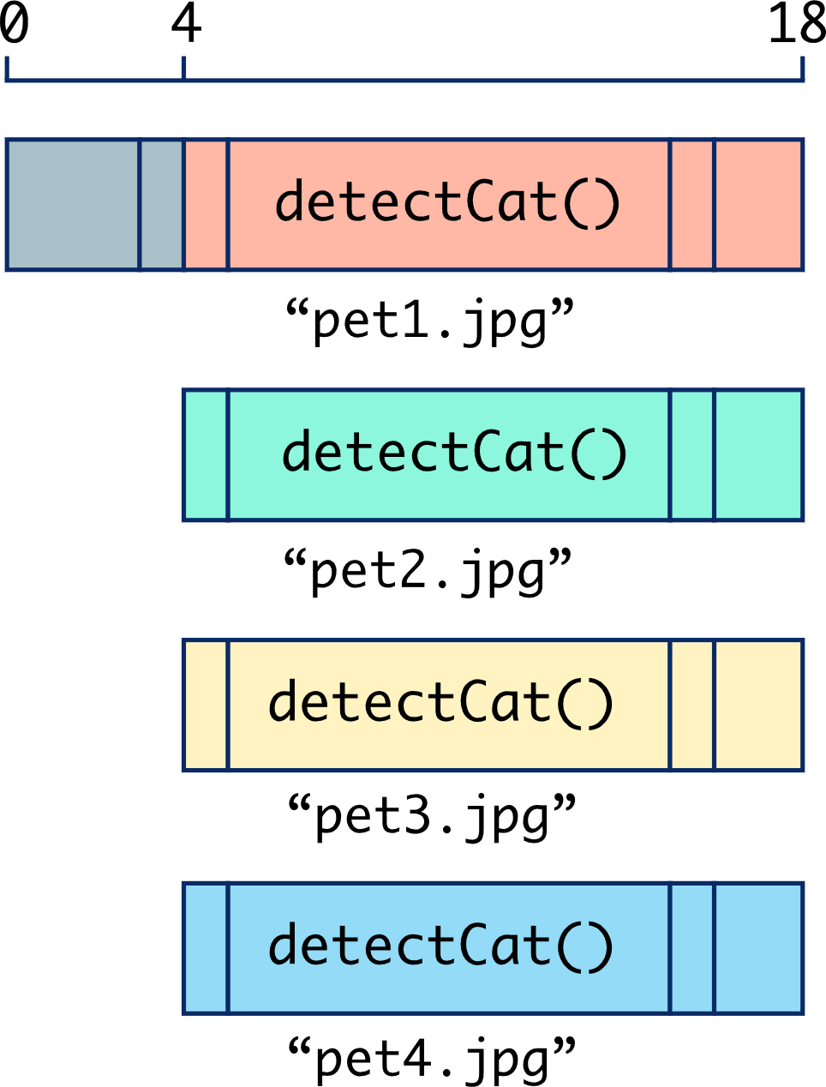
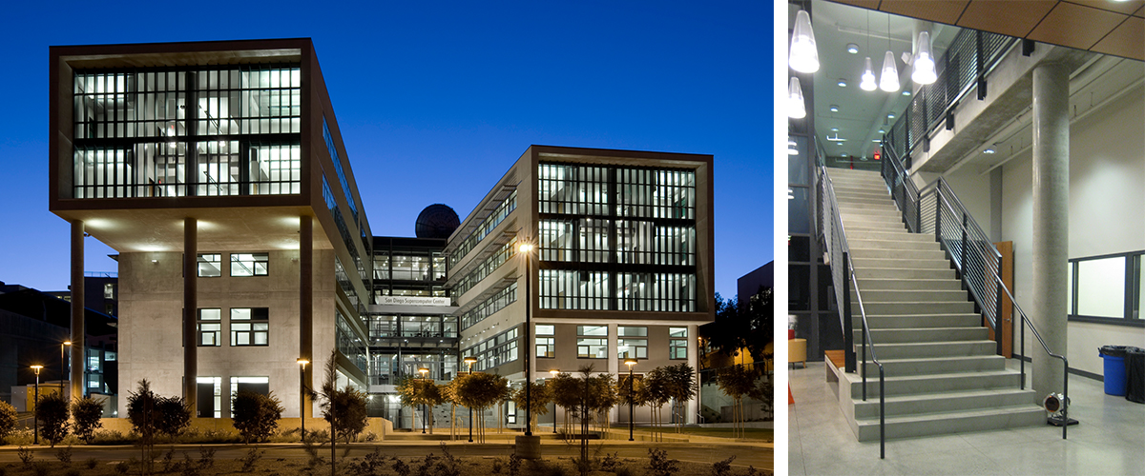
Big data processing solution
Parallel Computing
Running the task on a much more powerful machine (e.g. Supercomputers)
UCSD supercomputer center

Slide 20
Chapter 5 Outline
Data tools
Big Data
Machine Learning

Slide 21
Machine Learning Algorithms
* Optional
Supervised machine learning
Unsupervised machine learning
Reinforcement learning

Slide 22
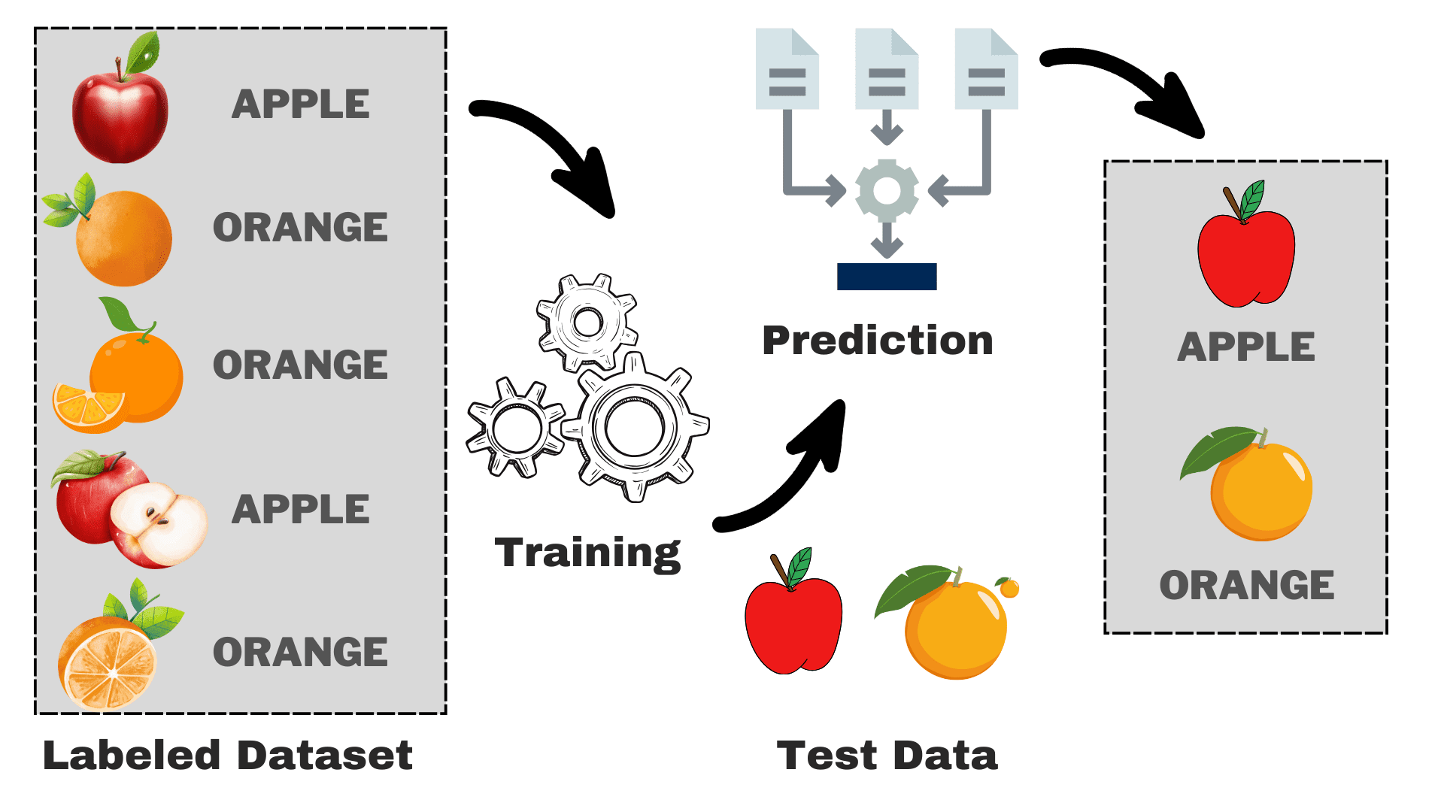
Machine Learning Algorithms
* Optional
Supervised learning: The algorithm analyzes labeled data and learns how to map input data to an output label. Often used for classification and prediction

Slide 23
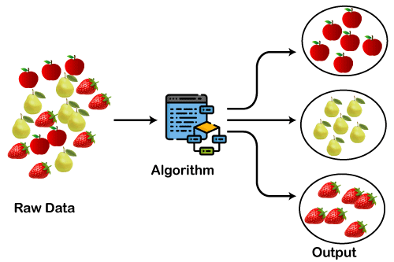
Machine Learning Algorithms
* Optional
Unsupervised machine learning: The algorithm finds patterns in unlabeled data by clustering and identifying similarities. Popular uses include recommendation systems and targeted advertising.

Slide 24
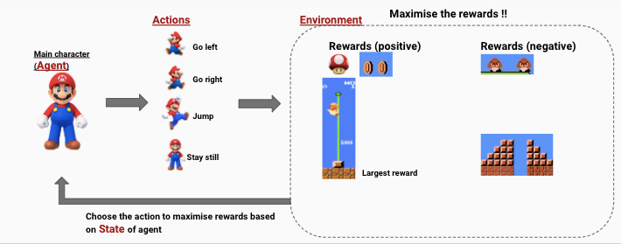
Machine Learning Algorithms
* Optional
Reinforcement learning: The algorithm performs actions that will be rewarded the most. Often used by game-playing AI or navigational robots.

Slide 25

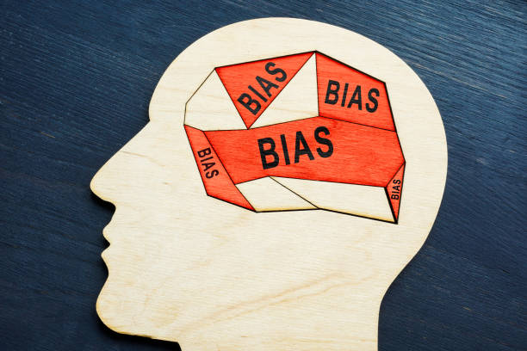
Machine Learning Bias
Data
Algorithm
Output

Slide 26
Bias in predictive algorithms
A machine learning algorithm can make a prediction about the future based on the historical data it's been trained on
However, if the training data is full of bias, the prediction will also be biased

Slide 27
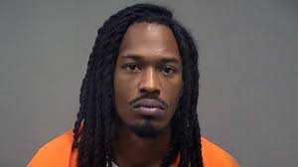
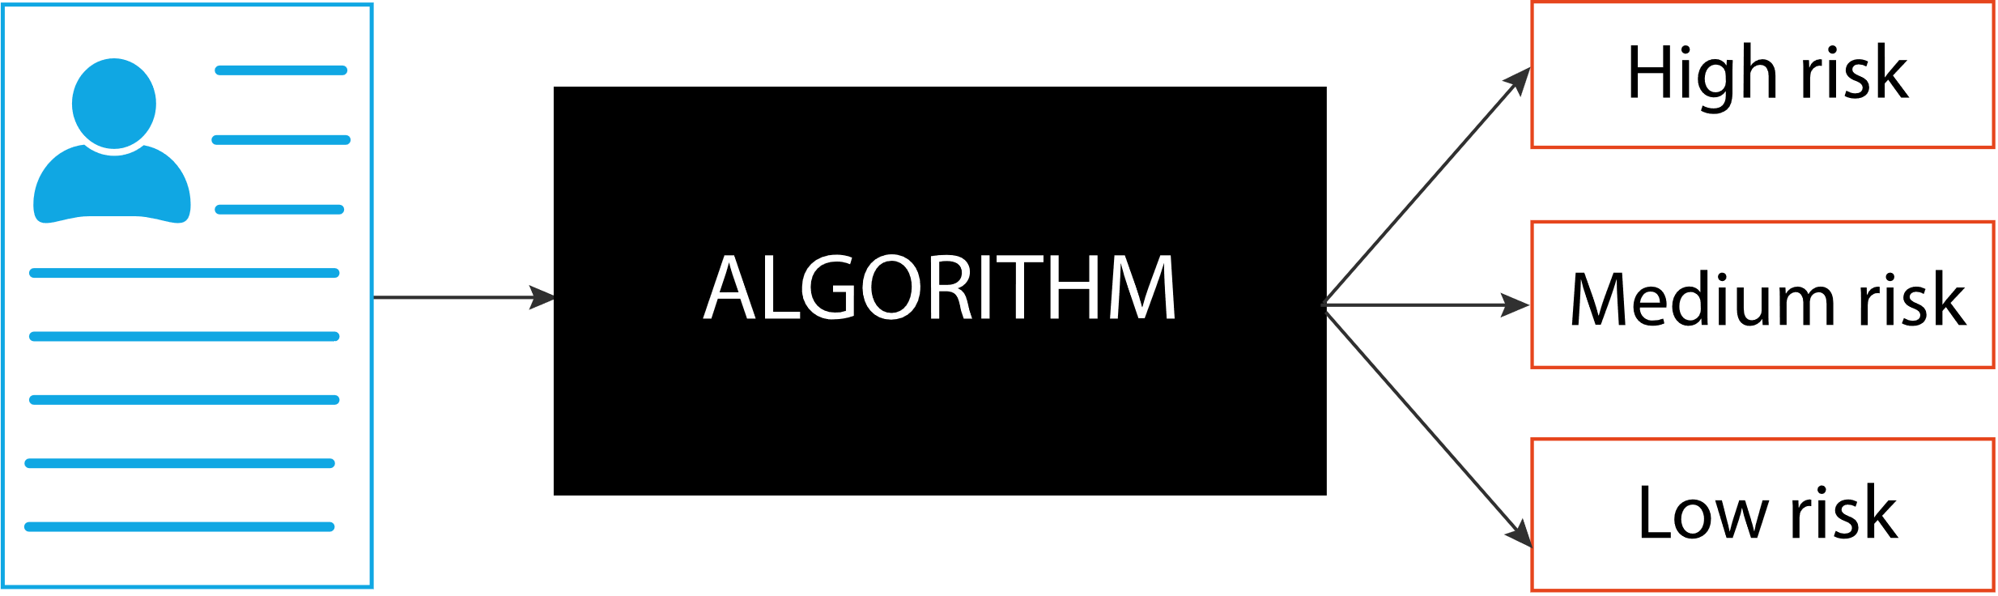


Criminal Justice
In the criminal justice system, a risk assessment score predicts whether someone accused of a crime is likely to commit another crime

Slide 28
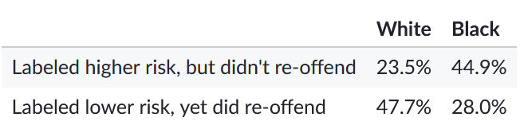
Bias in criminal justice prediction algorithm
In 2016, the investigative agency ProPublica analyzed the scores from an algorithm used in Florida on 7,000 people over a two-year period and checked whether those people actually did commit subsequent crimes.
They discovered that the algorithm underestimated the likelihood that white defendants would re-offend but overestimated the likelihood for Black defendants

Slide 29

Consequence of Bias in Criminal justice prediction
Determine sentences
10 Years v.s. 15 Years

Slide 30
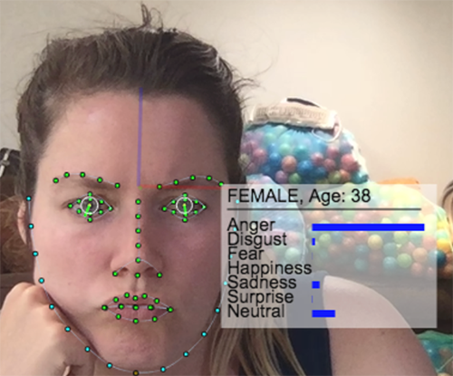
Facial recognition
Facial recognition services use machine learning algorithms to scan a face and detect a person's gender, race, emotions, or even identity.

Slide 31
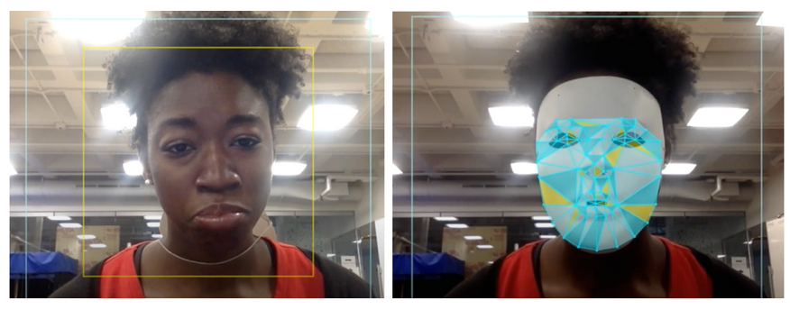
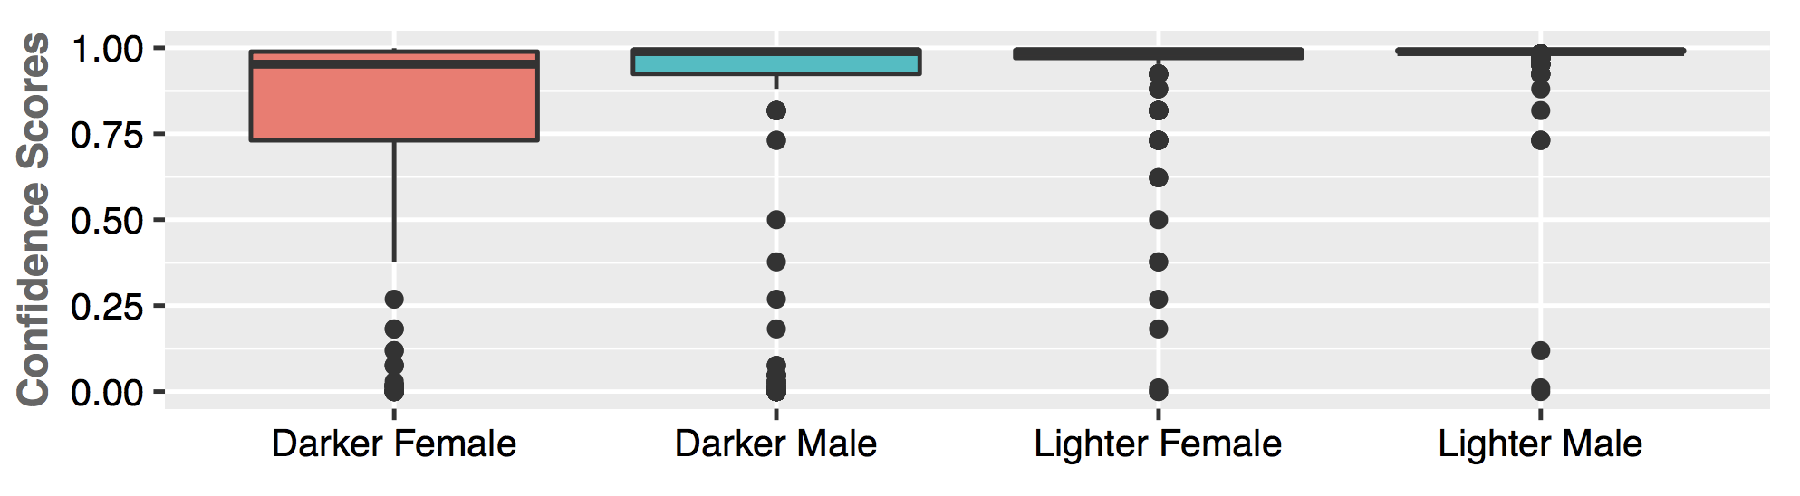
Bias in facial recognition - Accuracy
MIT researcher Joy Buolamwini discovered that she had to wear a white mask to get a facial recognition service to see her face at all
They found false positives were up to 100 times more likely for East Asian and African American faces when compared to white faces.
Face unrecognized
Face recognized with white mask
Facial Recognition accuracy varies across gender and race

Slide 32
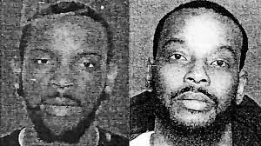
Consequences of bias in facial recognition
False arrest

Slide 33
End of Chapter 5

